Slide 1


Unit – 1.2 Counting
BTech & BSc (H)-CS $→$ 3rd Semester
Discrete Mathematics (2301HS301)
Prof. Vasudev Barjadiya
Department of Humanities & Science
vasudev.barjadiya@darshan.ac.in
901 64 27 400

Slide 2

Looping
Topics of Unit 1.2
The Basics of Counting
The Pigeonhole Principle

Slide 3

Looping
Outline of Unit 1.2
The Basics of Counting
The Pigeonhole Principle

Slide 4
Method 5
Basics of Counting

Slide 5
Basic Principles of Counting
We ﬁrst learn two basic counting principles:
Product Rule
Sum Rule

Slide 6
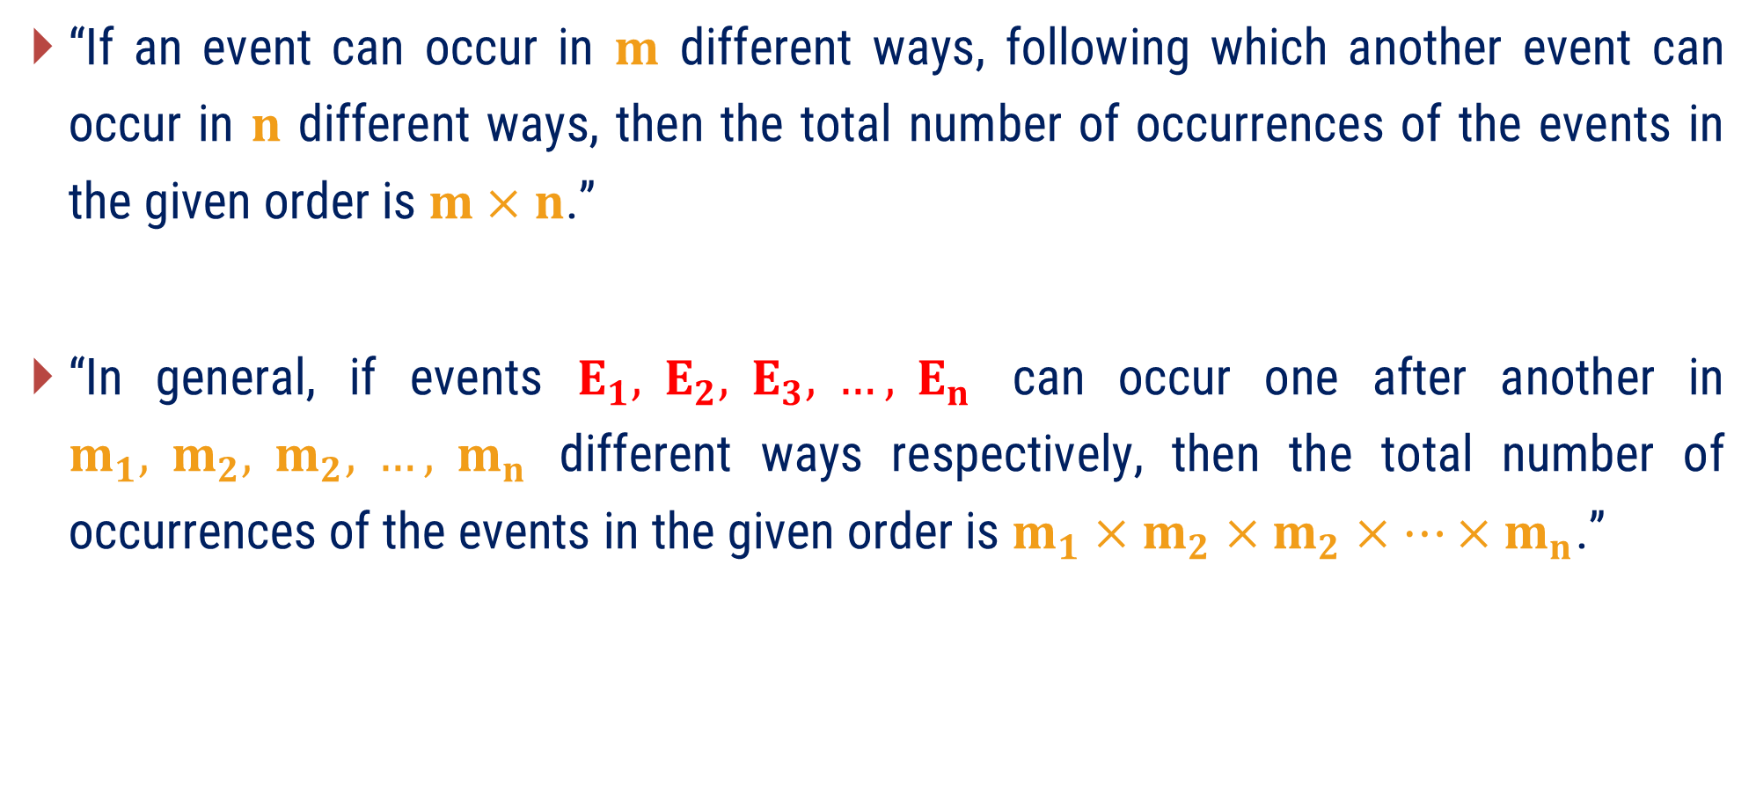
Product Rule
“If an event can occur in $m$ different ways, following which another event can occur in $n$ different ways, then the total number of occurrences of the events in the given order is $m×n$.”
“In general, if events $E_{1}, E_{2}, E_{3}, …, E_{n}$ can occur one after another in $m_{1}, m_{2}, m_{2}, …, m_{n}$ different ways respectively, then the total number of occurrences of the events in the given order is $m_{1}×m_{2}×m_{2}×…×m_{n}$.”

Slide 7
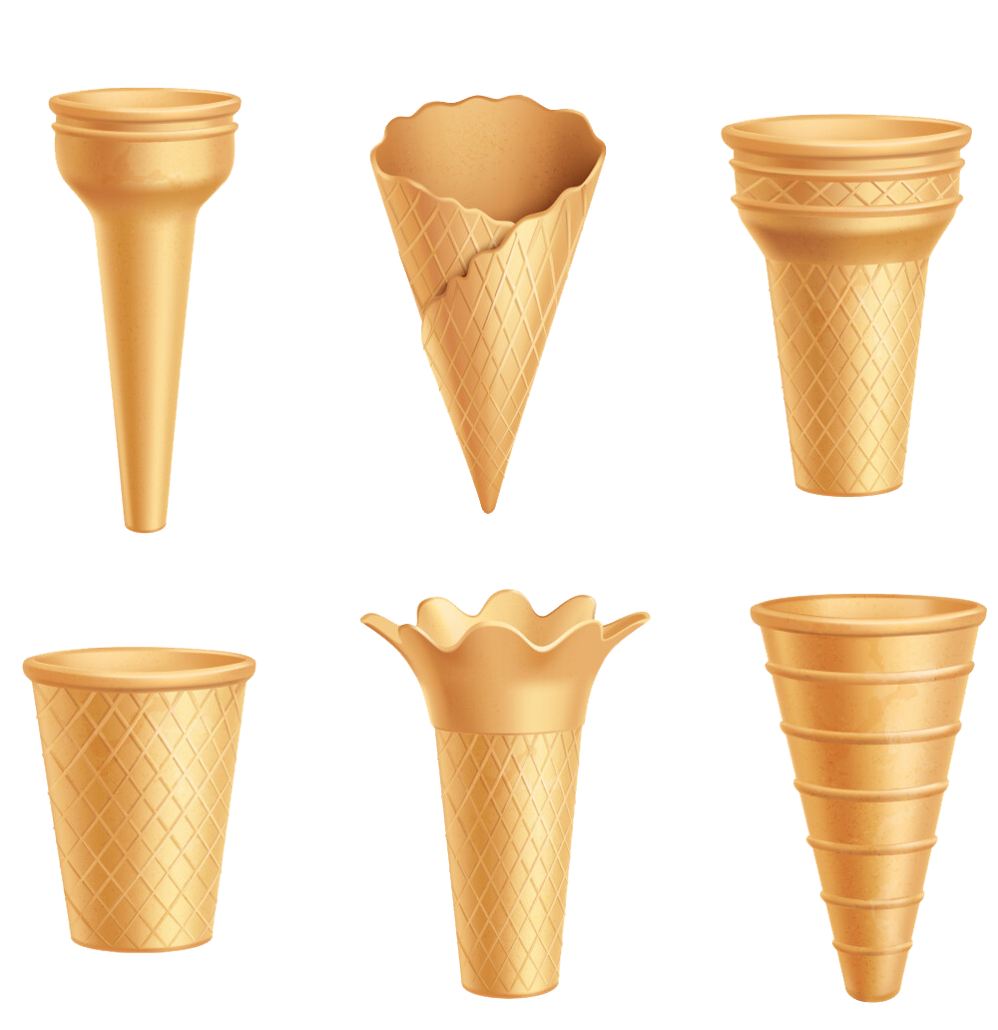
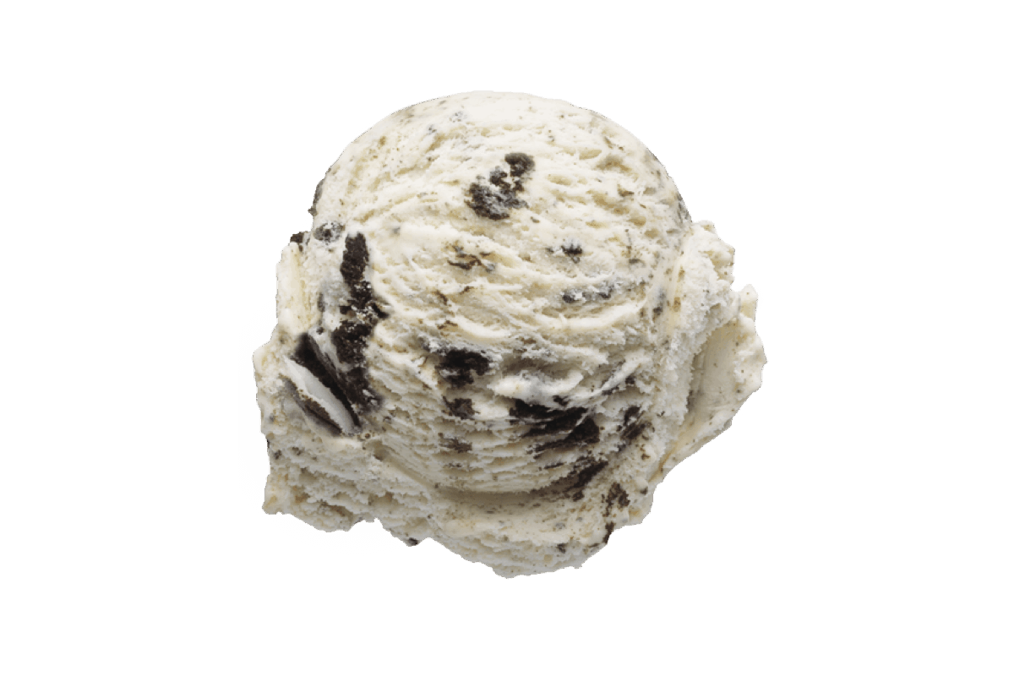
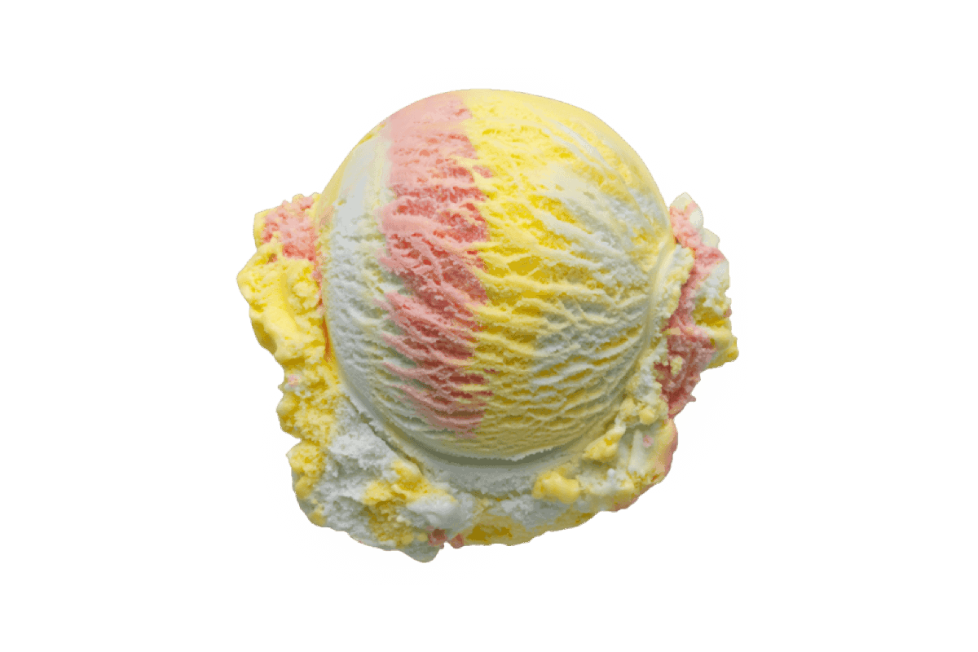

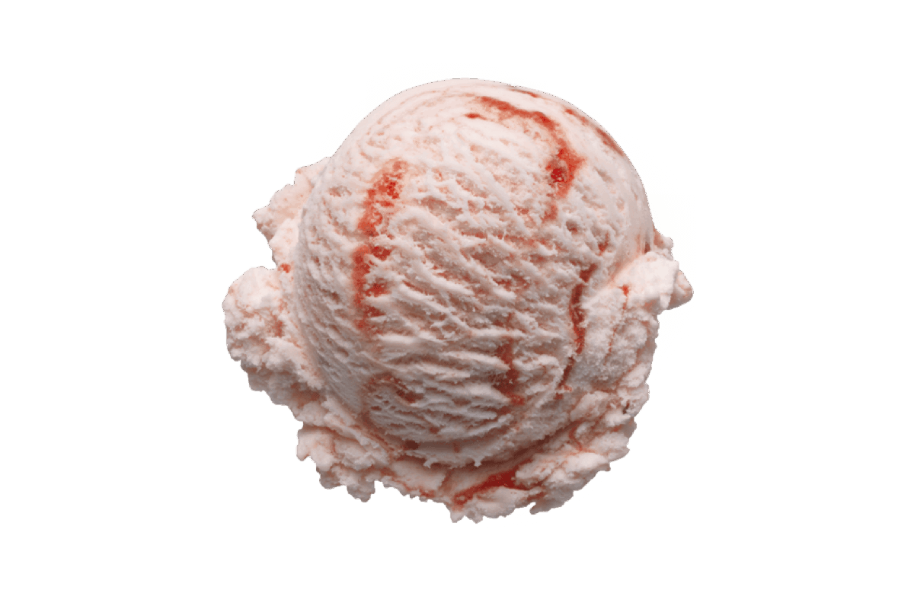
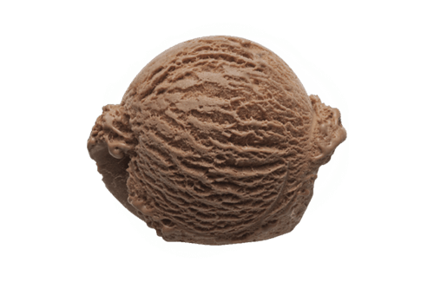
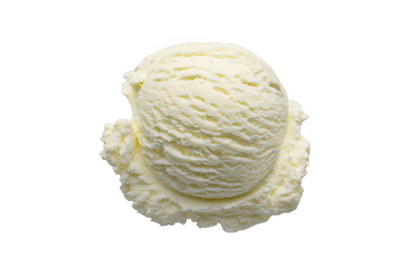

Product Rule
Consider following example to understand it better.
You went to buy an ice-cream.
There are 4 different choices for cones.
There are 5 different flavours of ice creams.
How many choices do you have?

Slide 8
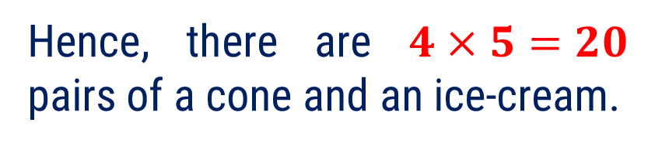
Product Rule
A cone can be chosen in 4 different ways.
An ice cream can be chosen in 5 different ways.
Hence, there are $4×5=20$ pairs of a cone and an ice-cream.

Slide 9
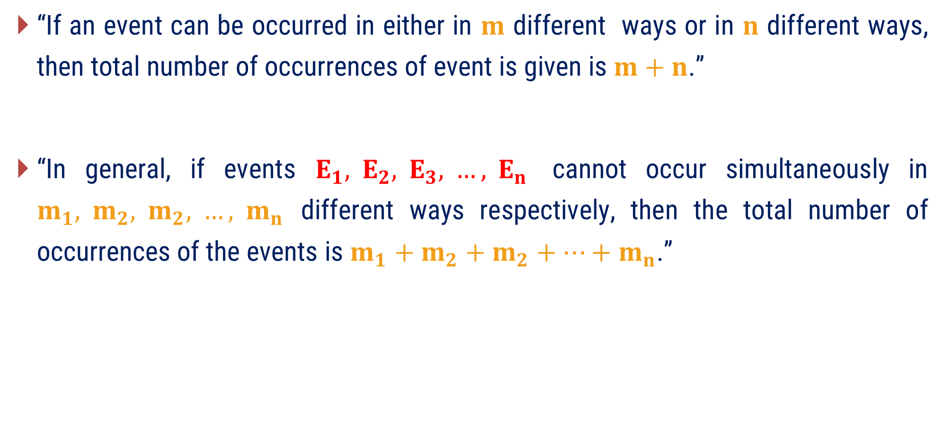
Sum Rule
“If an event can be occurred in either in $m$ different ways or in $n$ different ways, then total number of occurrences of event is given is $m+n$.”
“In general, if events $E_{1}, E_{2}, E_{3}, …, E_{n}$ cannot occur simultaneously in $m_{1}, m_{2}, m_{2}, …, m_{n}$ different ways respectively, then the total number of occurrences of the events is $m_{1}+m_{2}+m_{2}+…+m_{n}$.”

Slide 10

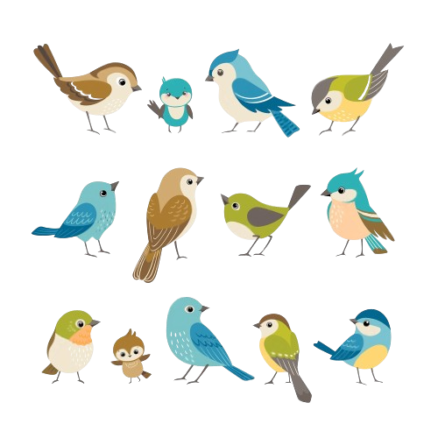
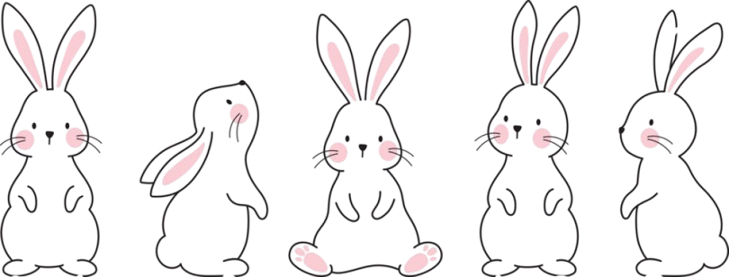

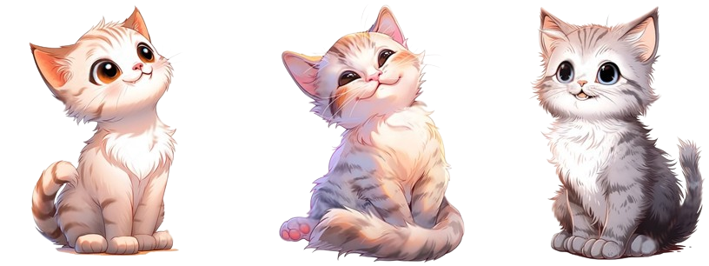
Sum Rule
Consider following example to understand it better.
You went to a pet shop
and find that the pet shop have
4 birds
3 cats
2 rabbits
7 fish
You can pick only one animal as a pet, how many choices do you have for a pet?

Slide 11
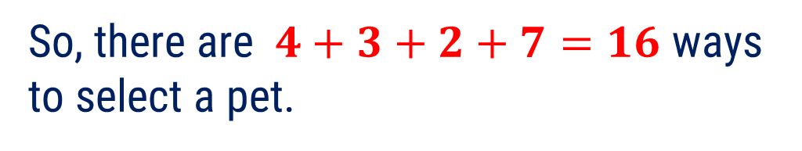
Sum Rule
You can choose
a bird or a cat or a rabbit or a fish.
4 birds
A bird can be chosen in 4 different ways.
3 cats
A cat can be chosen in 3 different ways.
A rabbit can be chosen in 2 different ways.
2 rabbits
A fish can be chosen in 7 different ways.
So, there are $4+3+2+7=16$ ways to select a pet.
7 fish

Slide 12
Examples of Method 5
Basics of Counting

Slide 13

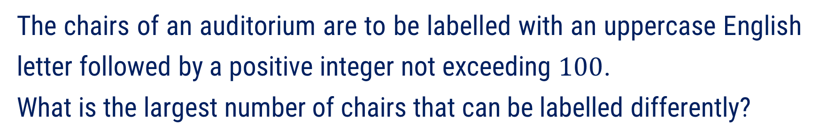


Method 5 ⇝ Example 1
Question:
The chairs of an auditorium are to be labelled with an uppercase English letter followed by a positive integer not exceeding $100$.
What is the largest number of chairs that can be labelled differently?
Solution:
This process of labelling consist of two tasks.
Assigning one of the $26$ uppercase English letter
and then assigning one of the $100$ possible integers to it.
By product rule there are
A
7
26
$$×$$
100
$$=$$
2600
different ways that a chair can be labelled.
26
100

Slide 14
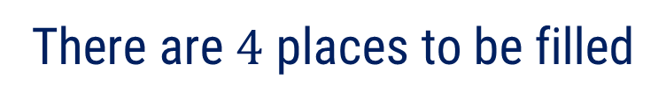
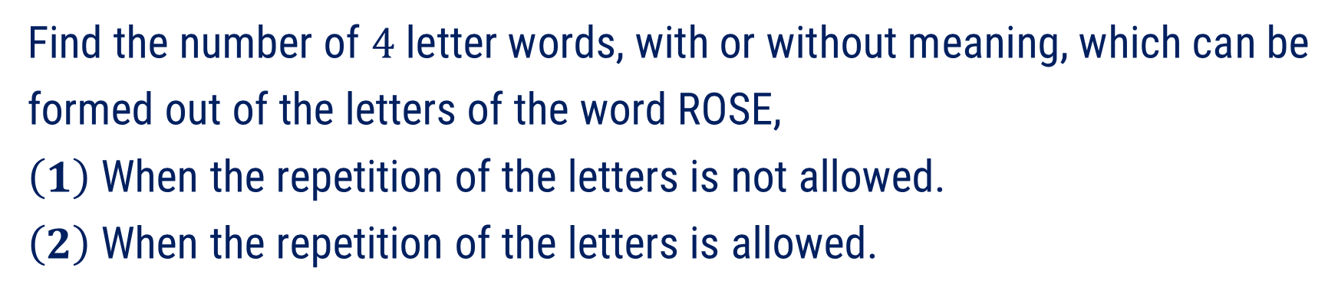
Method 5 ⇝ Example 2
Question:
Find the number of $4$ letter words, with or without meaning, which can be formed out of the letters of the word ROSE,
$\left(1\right)$ When the repetition of the letters is not allowed.
$\left(2\right)$ When the repetition of the letters is allowed.
Solution:
There are $4$ places to be filled
1st
2nd
3rd
4th
with given letters
R,
O,
S,
E.

Slide 15


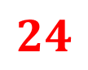












Method 5 ⇝ Example 2
(Continue)
$\left(1\right)$ Repetition of letters is not allowed
The 1st place can be filled in $4$ different by any one of the letters R, O, S, E.
The 2nd place can be filled by remaining $3$ letters in $3$ different ways.
The 3rd place can be filled in $2$ different ways.
The 4th place can be filled in $1$ way.
By product rule
The number of 4 letter words formed using the letters of the word ROSE without repetition of letters is
1st
2nd
3rd
4th
$$4$$
$$3$$
$$2$$
$$1$$
$$4$$
$$×$$
$$3$$
$$×$$
$$2$$
$$×$$
$$1$$
$$=$$
$$24$$

Slide 16


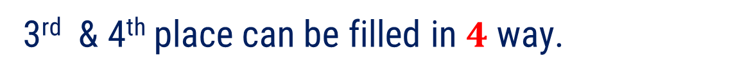

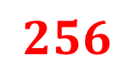









Method 5 ⇝ Example 2 (Continue)
$\left(2\right)$ Repetition of letters is allowed
The 1st place can be filled in $4$ different by any one of the letters R, O, S, E.
Since, repetition of letters is allowed.
The 2nd can be filled in $4$ different ways.
Similarly,
3rd & 4th place can be filled in $4$ way.
By product rule
The number of 4 letter words formed using the letters of the word ROSE without repetition of letters is
1st
2nd
3rd
4th
$$4$$
$$4$$
$$4$$
$$4$$
$$4$$
$$×$$
$$4$$
$$×$$
$$4$$
$$×$$
$$4$$
$$=$$
$$256$$

Slide 17
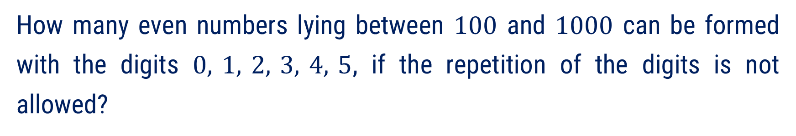
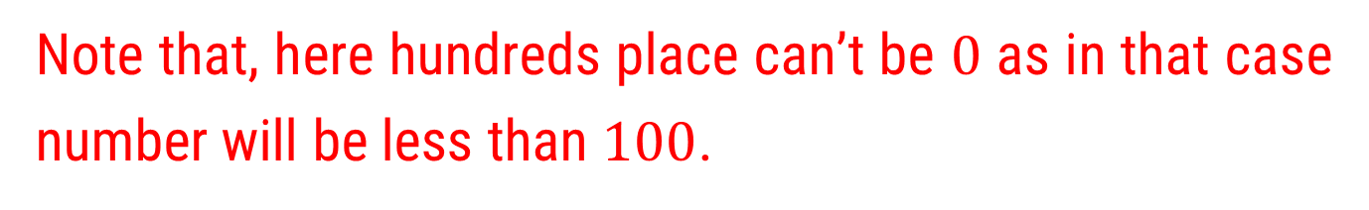
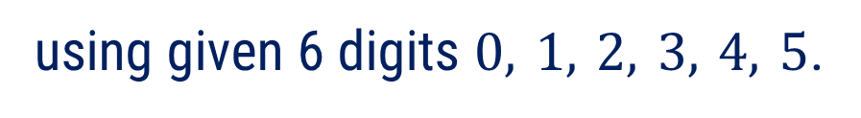
Method 5 ⇝ Example 3
Question:
How many even numbers lying between $100$ and $1000$ can be formed with the digits $0, 1, 2, 3, 4, 5$, if the repetition of the digits is not allowed?
Solution:
Numbers lying between $100$ and $1000$ are of three digits.
So, there are 3 places to be filled
Ones
O
H
T
O
Tens
T
using given 6 digits $0, 1, 2, 3, 4, 5$.
Hundreds
H
Note that, here hundreds place can’t be $0$ as in that case number will be less than $100$.

Slide 18
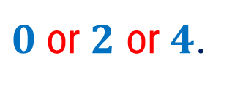
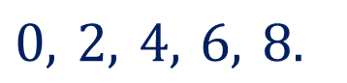
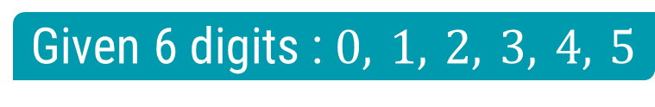
Method 5 ⇝ Example 3 (Continue)
Keeping in mind that repetition of the digits is not allowed let us proceed further.
To form an even number it must end with
$$0, 2, 4, 6, 8.$$
Given 6 digits : $0, 1, 2, 3, 4, 5$
So, ones place of these numbers can be either
$0$ or $2$ or $4$.

Slide 19






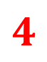









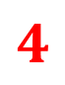

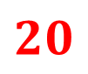







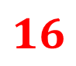






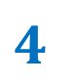
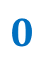







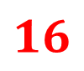


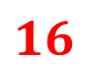

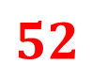










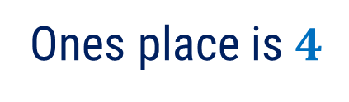

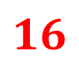
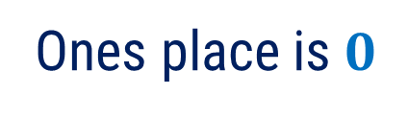







Method 5 ⇝ Example 3 (Continue)
Given 6 digits : $0, 1, 2, 3, 4, 5$
Case 1 :
Ones place is $0$
Case 2 :
Ones place is $2$
Case 3 :
Ones place is $4$
$$0$$
$$2$$
$$4$$
$$5$$
$$4$$
$$1$$
$$4$$
$$4$$
$$1$$
$$4$$
$$4$$
$$1$$
$$0$$
$$0$$
$$0$$
$$0$$
$$0$$
$$0$$
$$1$$
$$1$$
$$1$$
$$1$$
$$1$$
$$1$$
$$2$$
$$2$$
$$2$$
$$2$$
$$2$$
$$2$$
$$3$$
$$3$$
$$3$$
$$3$$
$$3$$
$$3$$
$$4$$
$$4$$
$$4$$
$$4$$
$$4$$
$$4$$
$$5$$
$$5$$
$$5$$
$$5$$
$$5$$
$$5$$
$$5$$
$$×$$
$$4$$
$$×$$
$$1$$
$$=$$
$$20$$
$$4$$
$$×$$
$$4$$
$$×$$
$$1$$
$$=$$
$$16$$
$$4$$
$$×$$
$$4$$
$$×$$
$$1$$
$$=$$
$$16$$
Now, by sum rule
total numbers can be formed are
$$20$$
$$+$$
$$16$$
$$+$$
$$16$$
$$=$$
$$52$$

Slide 20

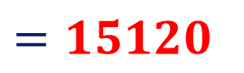
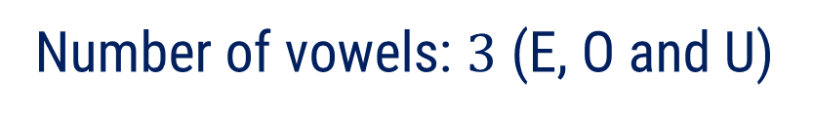

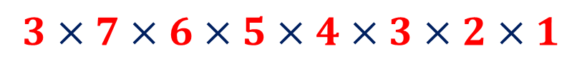




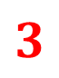
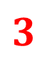
Method 5 ⇝ Example 4
Question:
How many words with or without meaning starting with a vowel can be
formed using letters of a words “COMPUTER”.
Solution:
Total number of letters: $8$
Number of vowels: $3$ (E, O and U)
$$3$$
$$7$$
$$6$$
$$5$$
$$4$$
$$3$$
$$2$$
$$1$$
First letter must be vowel.
So, total words can be formed are
$$3×7×6×5×4×3×2×1$$
$$=15120$$

Slide 21

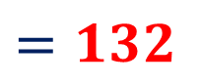
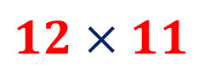
Method 5 ⇝ Example 5
Question:
A new company with just two employees, Adam and Paul, rents a ﬂoor of a building with 12 oﬃces. How many ways are there to assign diﬀerent oﬃces to these two employees?
Solution:
Adam can be assigned any of $12$ offices.
Paul can be assigned any of remaining $11$ offices.
So, total ways to assign offices are
$$12×11$$
$$=132$$

Slide 22
Method 6
Pigeonhole Principle

Slide 23
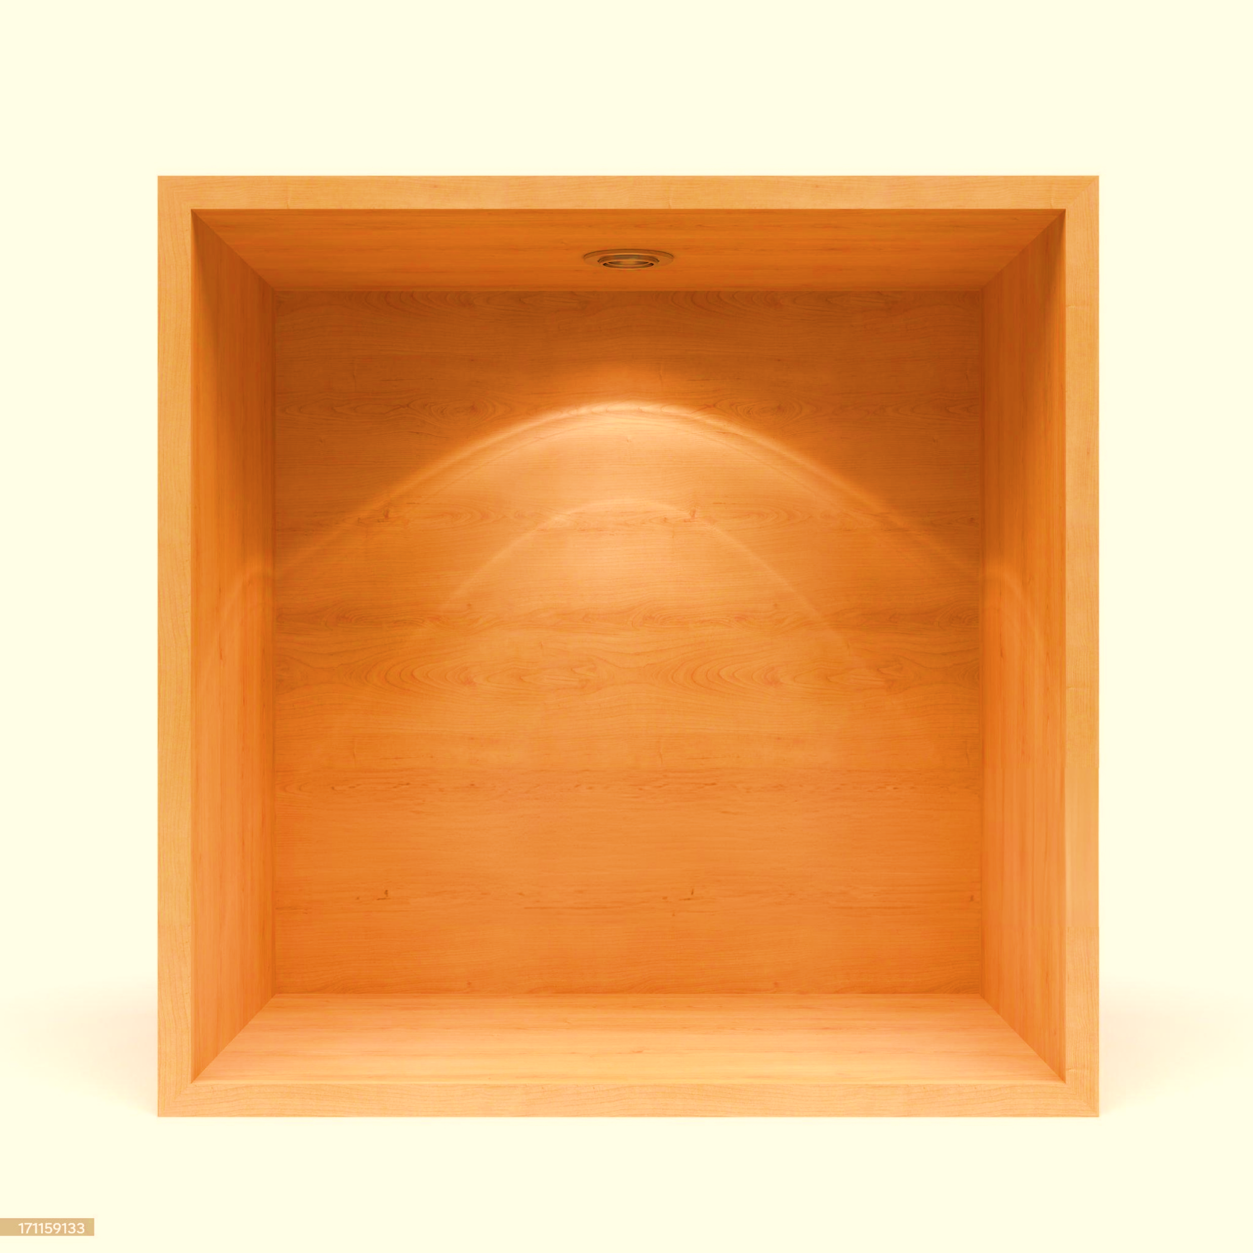


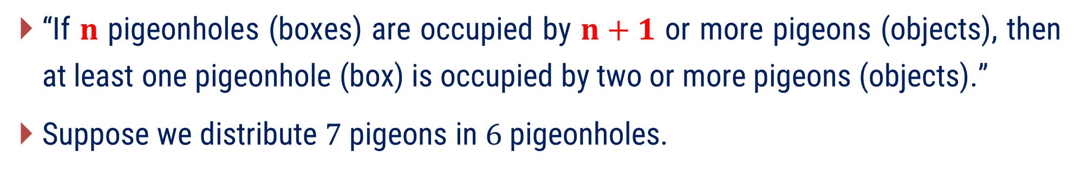
Pigeonhole Principle
“If $n$ pigeonholes (boxes) are occupied by $n+1$ or more pigeons (objects), then at least one pigeonhole (box) is occupied by two or more pigeons (objects).”
Suppose we distribute $7$ pigeons in $6$ pigeonholes.
The pigeonhole principle is also called the Dirichlet drawer principle.

Slide 24
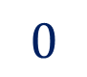
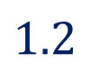
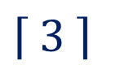
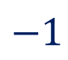











Least Integer Function or Ceiling Function (Prerequisite)
A function $f :ℝ→ℝ,$
$f\left(x\right)=\min\left\{ n∈ℤ :n≥x \right\}, ∀ x∈ℝ$
is known as a least integer function or ceiling function.
It is denoted by $\left\lceil x \right\rceil$ and read as “ceiling value of x”.
For example:
$\left\lceil 1.2 \right\rceil$
$$=2,$$
$$\left\lceil 3 \right\rceil$$
$$=3,$$
$$\left\lceil −1.7 \right\rceil$$
$$=−1$$
$$−1.7$$
$$1.2$$
$$−3$$
$$−2$$
$$−1$$
$$0$$
$$1$$
$$2$$
$$3$$

Slide 25


Generalized Pigeonhole Principle
“If $n$ pigeonholes are occupied by $kn+1$ or more pigeons, where $k$ is a positive integer, then at least one pigeonhole is occupied by $k+1$ or more pigeons.”
OR
“If $n$ boxes are occupied by $m$ objects provided $m>n$, then there is at least one
box containing at least objects.”
$$\left\lceil \begin{aligned} \\ \frac{ m }{ n } \\ \end{aligned} \right\rceil$$

Slide 26








Generalized Pigeonhole Principle
For example:
At least how many out of $100$ people would share same birth month?
$$n$$
$= 12$ months
(Boxes)
$$m$$
$=$ $100$ people
(Objects)
Now,
$$\left\lceil \begin{aligned} \\ \frac{ 100 }{ 12 } \\ \end{aligned}\right\rceil$$
$$=\left\lceil 8.33 \right\rceil$$
$$=9$$
Hence, among 100 people, at least $9$ would share same birth month.

Slide 27
Examples of Method 6
Pigeonhole Principle

Slide 28









Method 6 ⇝ Example 1
Question:
If there are $30$ students in a class, then at least how many would have last names that begin with the same letter?
Solution:
Here,
$$n$$
$$=26$$
No. of alphabets
(Boxes)
$$m$$
$$=30$$
No. of students
(Objects)
Now,
$$\left\lceil \begin{aligned} \\ \frac{ 30 }{ 26 } \\ \end{aligned} \right\rceil$$
$$=\left\lceil 1.15 \right\rceil$$
$$=2$$
Hence, at least $2$ students have last names that begin with the same letter.

Slide 29














Method 6 ⇝ Example 2
Question:
What is the minimum number of students required in a discrete mathematics class to be sure that at least six will receive the same grade, if there are ﬁve possible grades, A, B, C, D, and E?
Solution:
Here,
$$n$$
$$=5$$
Five grades
(Boxes)
Let minimum number of students be
$$kn+1$$
such that
$$k+1=6$$
$$⇒$$
$$k=5$$
Now, minimum number of students is
$$kn+1$$
$$=$$
$$5$$
$$⋅5$$
$$+ 1$$
Hence, minimum $26$ students are required in a class to be sure that at least six will receive the same grade.
$$=$$
$$26$$

Slide 30








Method 6 ⇝ Example 3
Question:
A laundry bag contains many red, white and blue socks. Find the minimum number of socks that one needs to choose in order to get four pairs (eight socks) of the same colour.
Solution:
Here,
$$n$$
$$=3$$
Three Colours
(Boxes)
Let minimum number of socks to be chosen
$$kn+1$$
such that
$$k+1=8$$
$$⇒$$
$$k=7$$
Now, minimum number of socks to be chosen is
$$kn+1$$
$$=$$
$$7$$
$$⋅3$$
$$+ 1$$
Hence, one needs to chose minimum $22$ socks in order to get four pairs (eight socks) of the same colour.
$$=$$
$$22$$

Slide 31














Method 6 ⇝ Example 4
Question:
How many cards must be selected from a standard deck of 52 cards to
guarantee that at least three cards of the same suit are selected?
Solution:
Here,
$$n$$
$$=4$$
Four suits
(Boxes)
Let minimum number of cards to be chosen
$$kn+1$$
such that
$$k+1=3$$
$$⇒$$
$$k=2$$
Now, minimum number of socks to be chosen is
$$kn+1$$
$$=$$
$$2$$
$$⋅4$$
$$+ 1$$
Hence, one needs to chose minimum $9$ cards in order to get three cards of the same suit .
$$=$$
$$9$$

Slide 32













Method 6 ⇝ Example 5
Question:
What is the minimum number of employees in a company so that there will be at least 10 employees in one department and the departments in the company are HR, Marketing, Tech and Support?
Solution:
Here,
$$n$$
$$=4$$
Four departments
(Boxes)
Let minimum number of cards to be chosen
$$kn+1$$
such that
$$k+1=10$$
$$⇒$$
$$k=9$$
Now, minimum number of socks to be chosen is
$$kn+1$$
$$=$$
$$9$$
$$⋅4$$
$$+ 1$$
Hence, there are minimum $37$ employees in a company.
$$=$$
$$37$$

